Slide 1
Towards Large Scale Semantic Annotation Built on MapReduce Architecture
Michal Laclavík, Martin Šeleng, Ladislav Hluchý
Institute of Informatics
Slovak Academy of Sciences in Bratislava
ICCS 2008, Cracow
June 23-25, 2008

Slide 2
Motivation
Semantic Annotation or Tagging
  Deliver formal understanding of text documents one of main focuses of semantic web
  Documents on Web or in enterprise to be understood by computer
  To understand content and context
ICCS 2008, Cracow
June 23-25, 2008

Slide 3
Semantic Annotation
Similar to Information Extraction
Finding meta data about entities, its properties and their relations
Ontologies
Manual tools
(Semi) Automatic tools
  Usually tested on a few hundreds documents
Needs:
  To deliver application on the web or in enterprises we need to annotate large scale
  Semantic Web can be exploited only if metadata understood by a computer reach critical mass
Examples:
  Geographical locations, People, Organizations
ICCS 2008, Cracow
June 23-25, 2008

Slide 4
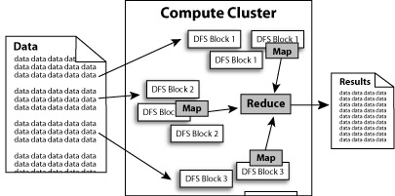
MapReduce
Google approach for large scale information processing
Commodity PC’s
Application developer needs to implement only Map and Reduce methods
Inputs and outputs are ordered key-value pairs
Fault tolerant, easy to use, scalable to
hundred thousands computers
Hadoop
  open source
  implementation
  by Apache
  Yahoo! is using it on
  10 000 cores in
  production environment.
ICCS 2008, Cracow
June 23-25, 2008

Slide 5
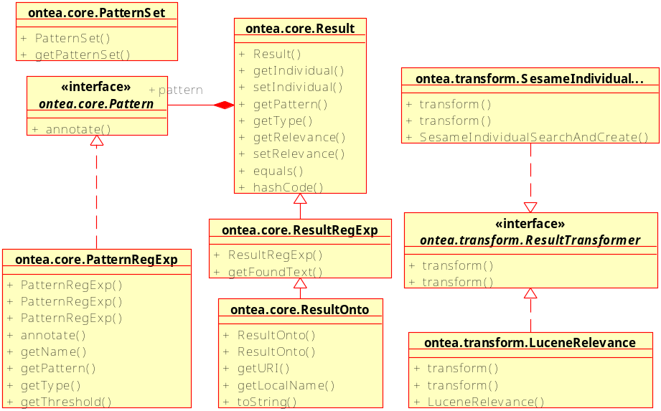
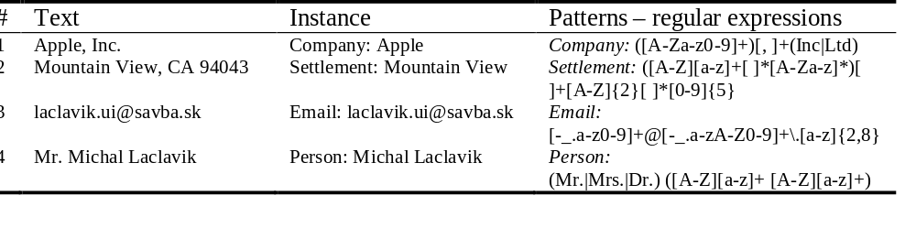
Ontea: Pattern Based Annotation
Information extraction and semantic annotation using patterns
Find objects and properties in text
Possibility to transform it to RDF/OWL
Similar to C-PANKOW, KIM or GATE
Very simple solution good for languages
where advanced NLP is not present
Applicable in enterprise applications
ICCS 2008, Cracow
June 23-25, 2008

Slide 6
Ontea in Hadoop
Map function - Pattern.annotation()
  Input lines of text
  Output key-value pairs e.g.
    file_name => organization:Apple
    Organization:Apple=>address:Mountain View
Map function – transformers
  E.g. lemmatization transformer
  input: Settlement:Bratislave,Settlement:Bratislava
  Output: Settlement:Bratislava
Reduce function
  input key-value pairs (objects and properties)
  Output as needed – objects and its relations to files with properties (e.g. in RDF/OWL)
ICCS 2008, Cracow
June 23-25, 2008

Slide 7
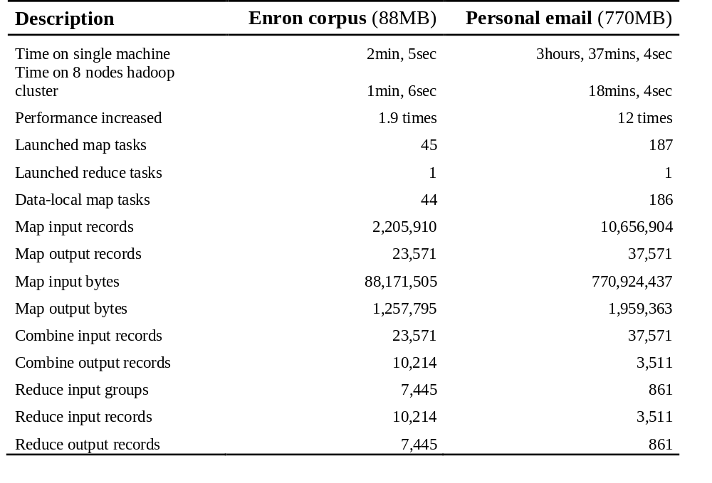
Results & Conclusion
It works, it is portable, it is faster
12 times faster on 16 cores
http://ontea.sourceforge.net/
ICCS 2008, Cracow
June 23-25, 2008

